Slide 1
CHANGE HEALTHCARE CYBERATTACK(2024)
Urgent Need to Strengthen Cyber Preparedness
Dr. A. Ezhil Grace
SIMATS Engineering
Mounnila S P
192511188

Slide 2
INTRODUCTION
Change Healthcare is a major healthcare technology provider.
It processes 15 billion healthcare transactions every year.
On February 21, 2024, it suffered a ransomware attack.
The attack disrupted hospitals across the United States.
It highlighted the importance of strong cybersecurity in healthcare.

Slide 3
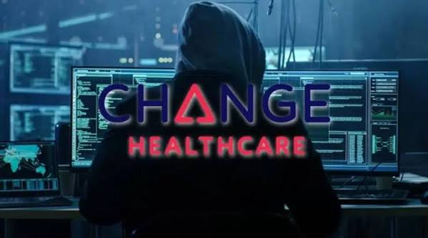
ATTACK OVERVIEW
Attack by ALPHV BlackCat ransomware group.
Systems were encrypted and shut down.
Insurance verification stopped.
Prescription processing was interrupted.
Claims and payment systems failed.

Slide 4
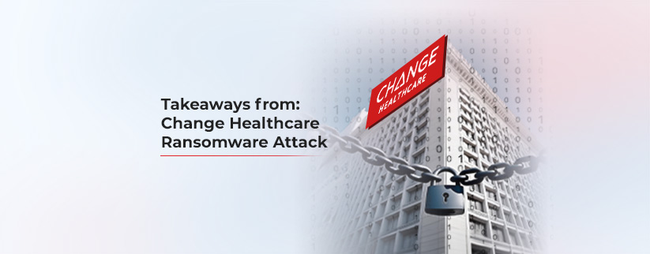
MAJOR IMPACTS
Impact on Healthcare
74% of hospitals reported patient care disruption.
94% experienced financial impact.
33% lost more than half of their revenue.
Around 100 million patient records were exposed.
Recovery took 2 weeks to 3 months.
Result:
Delayed treatments
Manual paperwork
Increased operational costs

Slide 5
LESSONS LEARNED
Key Lessons:
Third-party vendors are major cybersecurity risks.
Avoid depending on a single service provider.
Prepare backup systems.
Regular cybersecurity training is essential.
Hospitals must have strong disaster recovery plans.
Important Message: Cybersecurity is critical for patient safety.

Slide 6
RECOMMENDATIONS
Cybersecurity Recommendations:
Implement Third-Party Risk Management (TPRM).
Conduct regular security audits.
Test backup and recovery systems.
Train staff for cyber incidents.
Collaborate with FBI, CISA, and HHS.

Slide 7
CONCLUSION
The Change Healthcare Cyberattack Became One Of The Largest Healthcare Cyber Incidents.
It Exposed Weaknesses In Third-party Cybersecurity.
Healthcare Organizations Should Improve Cyber Preparedness, Backup Planning, And Vendor Management.
Strong Cybersecurity Helps Protect Both Patients And Healthcare Services.

Slide 8
Thank you

